Slide 1
Proof-of-Concept: NServiceBus
March 2018
Digital Team

Slide 2
Customer Portal Architecture
Message Bus Concept
Where does the Message Bus Fit
NServiceBus Overview
NServiceBus Terminologies
A Case Study – the Ordering Process
NServiceBus in Action
Unit Testing
Logging
Appendices

Slide 3
Customer Portal Architecture
Service API Layer
Service Processing Engine Layer
Platform Integration Layer
Three logical layers
The Service API Layer serves both portal Web UI and mobile client apps via RESTful services
The Service Processing Engine Layer is a middleware layer that provides mechanism to decouple service infrastructure from business functionality.
The Platform Integration Layer handles integration with various backend platforms
Issues:
Scalability: calls to the API will be blocked the entire time when the Platform Integration Layer is processing the request with back ends, limiting the number of requests the API handles
Lack of Fault Tolerance: Should the back ends becomes unavailable, the entire system stops functioning

Slide 4
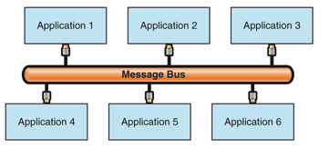
Introducing Message Bus
All applications are connected through a logical component known as a message bus.
Message buses specialize in transporting messages between applications.
A message bus usually contains three key elements:
A set of agreed-upon message schemas
A set of common command messages
A shared infrastructure for sending bus messages to recipients
Message Buses are usually implemented using a Message Broker (Message Queuing Engine)

Slide 5
Where Does a Message Bus Fit?
Service API Layer
Message Bus Layer
Service Processing Engine Layer
Platform Integration Layer
A Message Bus Layer will sit between the Service API Layer and the Platform Integration Layer, just like current Service Processing Engine Layer
The Message Bus Layer consists
RabbitMQ – a robust message broker which provides fault tolerance and scalability
NServiceBus – an abstraction layer sits on top of RabbitMQ with added values such as transaction (via “Outbox” pattern) and process management (vis “Saga”)

Slide 6
Introducing NServiceBus
NServiceBus is a .NET platform from Particular Software that implements a light weight Message Bus architecture.
NServiceBus is an abstraction layer that builds on top of a messaging broker (such as RabbitMQ, Azure Service Bus and AWS SQS)
NServiceBus can be used standalone at Standard License level.
Additional monitoring tools (NServiceControl, NServicePulse and NServiceInsight) are available at Enterprise License level.
We’ve decided against the Enterprise License for the following reasons:
Standard License provides all core functionalities of a Message Bus but only costs a quarter of the Enterprise License price
All additional components come with Enterprise License are Windows Services which creates an affinity to Microsoft Windows OS, making it harder to migrating to a cloud platform
We can (and should) implement logging/instrumentation at application level and leverage our enterprise monitoring tools (e.g., Stackify)

Slide 7
NServiceBus Terminologies
Messages
Commands: Do Something
Events: Something Happened
Unobtrusive Mode: Decouples message producers from consumers
Message Processing
Message Handlers: listen and handle commands and events
Sagas: a special message handler that can manage long running processes and workflows
Endpoints - Queues
Outbox Pattern
Pub/Sub architecture
DDD/Microservices concepts:
Domain Events
Integration Events

Slide 8
Current Order Process – A Case Study

Slide 9
NServiceBus in Action: Order Processing

Slide 10
Services and Their Roles
Services | Roles in Message Bus
API | An Command Sender that sends CreateOrderCommand to the bus and initializes the workflow process
Saga | A stateful “orchestrator” that performs the following: Listens to CreateOrderCommand from the bus Publishes a OrderReceivedEvent to the bus Waits for and coordinates the OrderProcessedEvent from the bus and checks order processing results (succeeded or failed) If the order processing failed, it sends a SendNotificationCommand to the bus
Platform Handler | Listens to OrderReceivedEvent from the bus and Handles it (in the real world situation, it would invoke the Platform Integration Layer to perform CRUD operations against the back end). Sends an OrderProcessedEvent to the bus with the results
Email Notification Handler | Listens to the SendNotificationCommand from the bus and processing email notifications.

Slide 11
Demo: A Containerized Deployment

Slide 12
Unit Testing
NServiceBus provides a NuGet package, NServiceBus.Testing to unit test its artifacts, including
Message Handlers
Sagas
Pipeline Behaviors
It supports two testing styles:
Arrange, Act, Assert (AAA)
Fluent style
It supports multiple unit test frameworks:
xUnit
NUnit
MSTest

Slide 13
Structured Logging with Serilog
You can define your message template with arbitrarily named properties (in the form of {xxx})
Each property is a searchable item in tools like Stackify and Elasticsearch

Slide 14
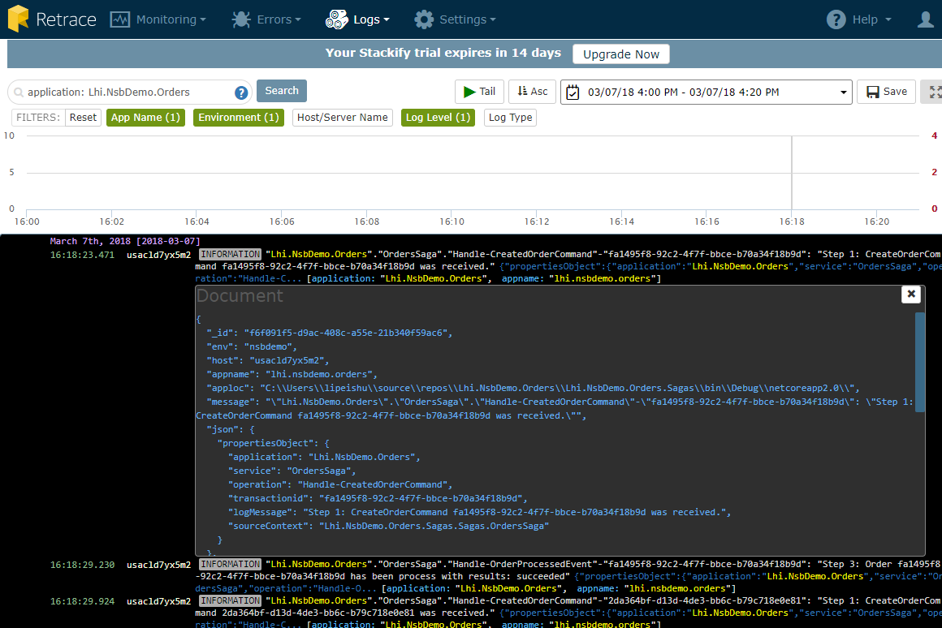
Logged Data in Stackify

Slide 15
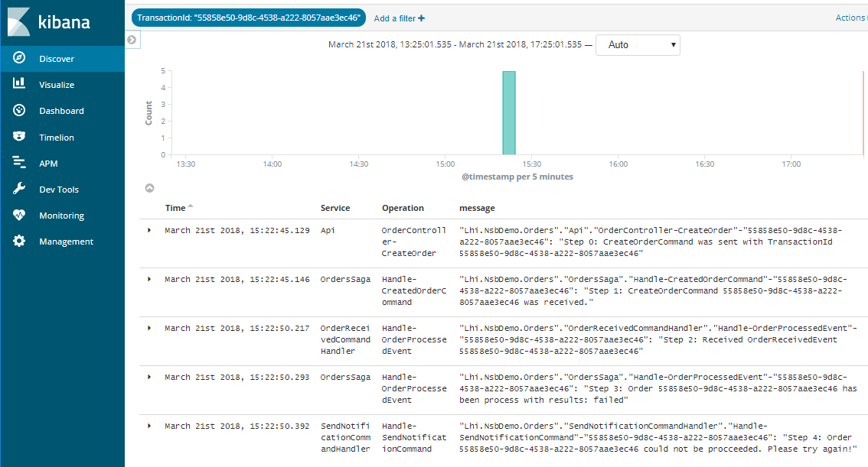
Logged Data in Elasticsearch (Kibana)

Slide 16
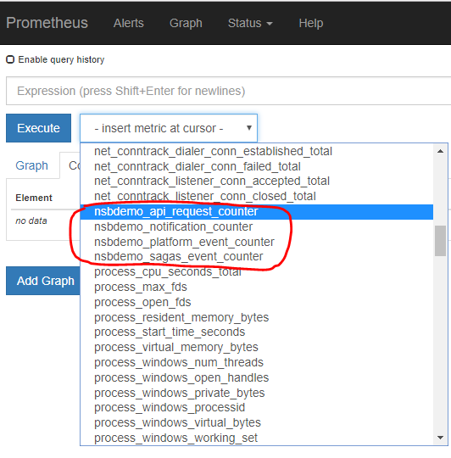
Instrumentation (Prometheus)
App Defined
Custom Counters

Slide 17
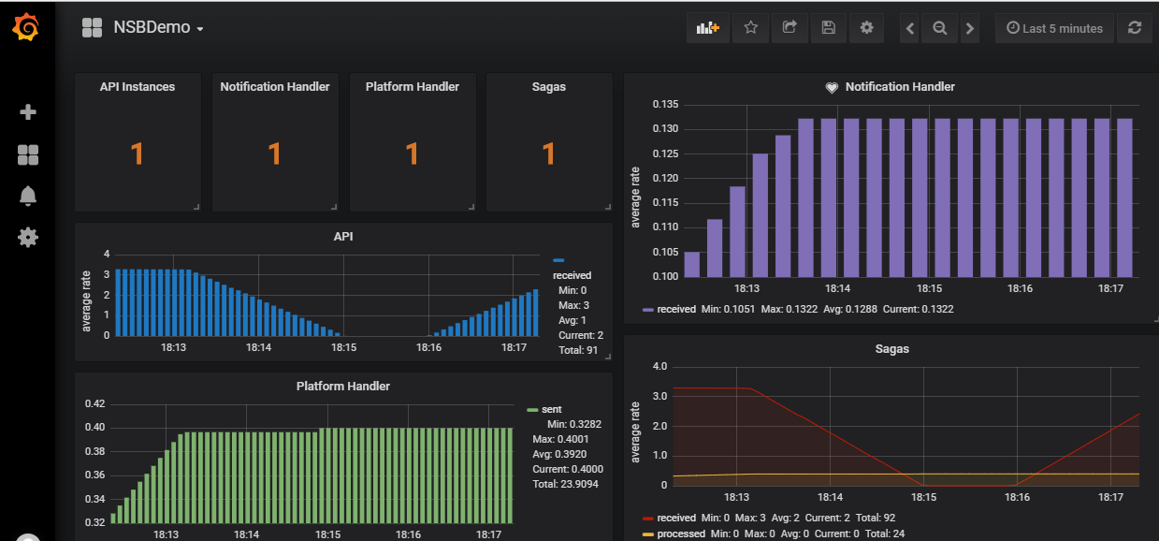
Instrumentation (Grafana)
Visualization

Slide 18

Questions
Please send any questions or comments directly to the author.

